Slide 1
ARAS Security A/S
Way ahead… and just around the corner

Slide 2

Complete supplier of security solutions
High quality products
Demonstration
Counseling & evaluation
Development
Specialized knowledge
Education
Project guidance
Support

Slide 3

Combined and integrated system
Access Control
Video Surveillance
Burglar Alarm
Climate Control
Building Management
Fire Alarm
…………

Slide 4
Get what you need – scale up later
NOX Corporate
The complete system.
Open for the full suite of NOX software and hardware products.
3x RS485 BUS
NOXONE
Designed for small and medium sized locations.
1x RS485 BUS

Slide 5
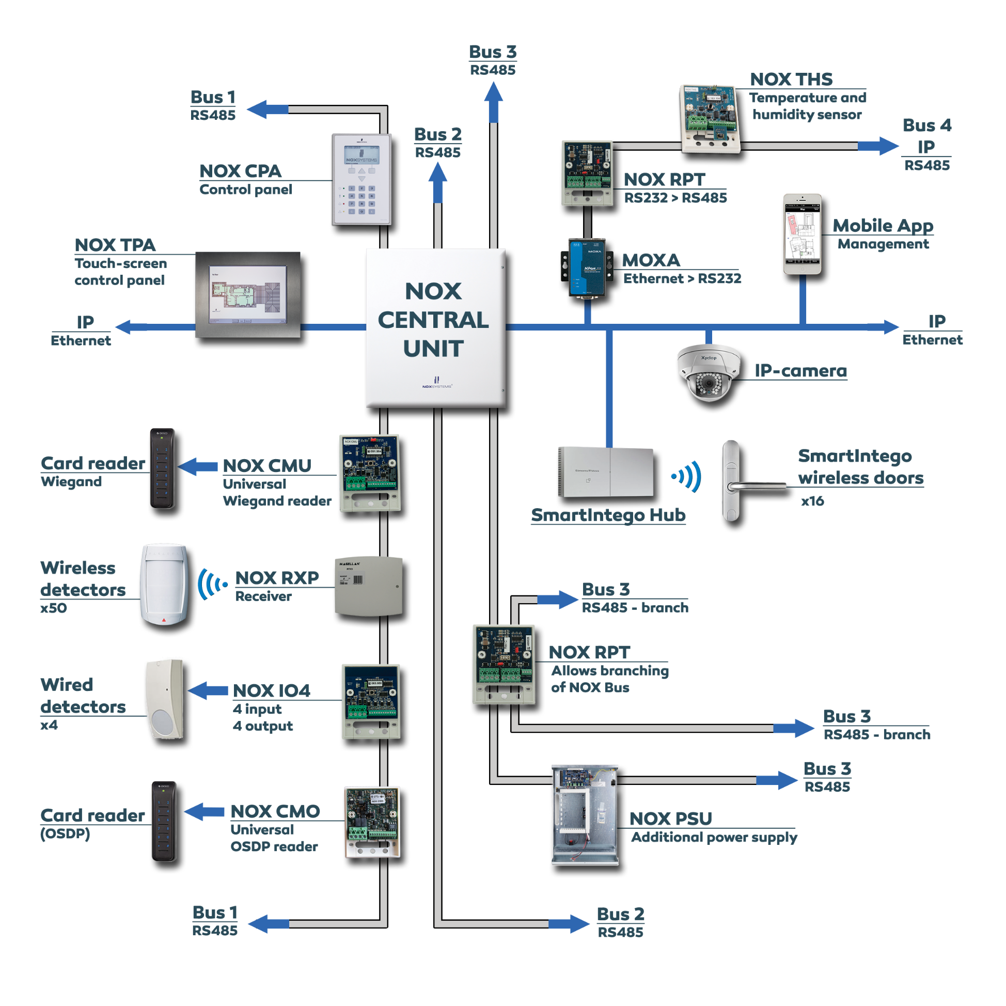
NOX Corporate
Flexible setup with 3 physical NOX busses (two-way)
Up to 2088 inputs (e.g., detectors) per central unit
Up to 75 wired door modules per central unit (25 per bus)
Wireless doors (Online/Offline) with SmartIntego
Wireless detectors and alarms via Paradox receivers
Core combination of Access Control and Burglar alarm
Open for secure integrations to everything open

Slide 6
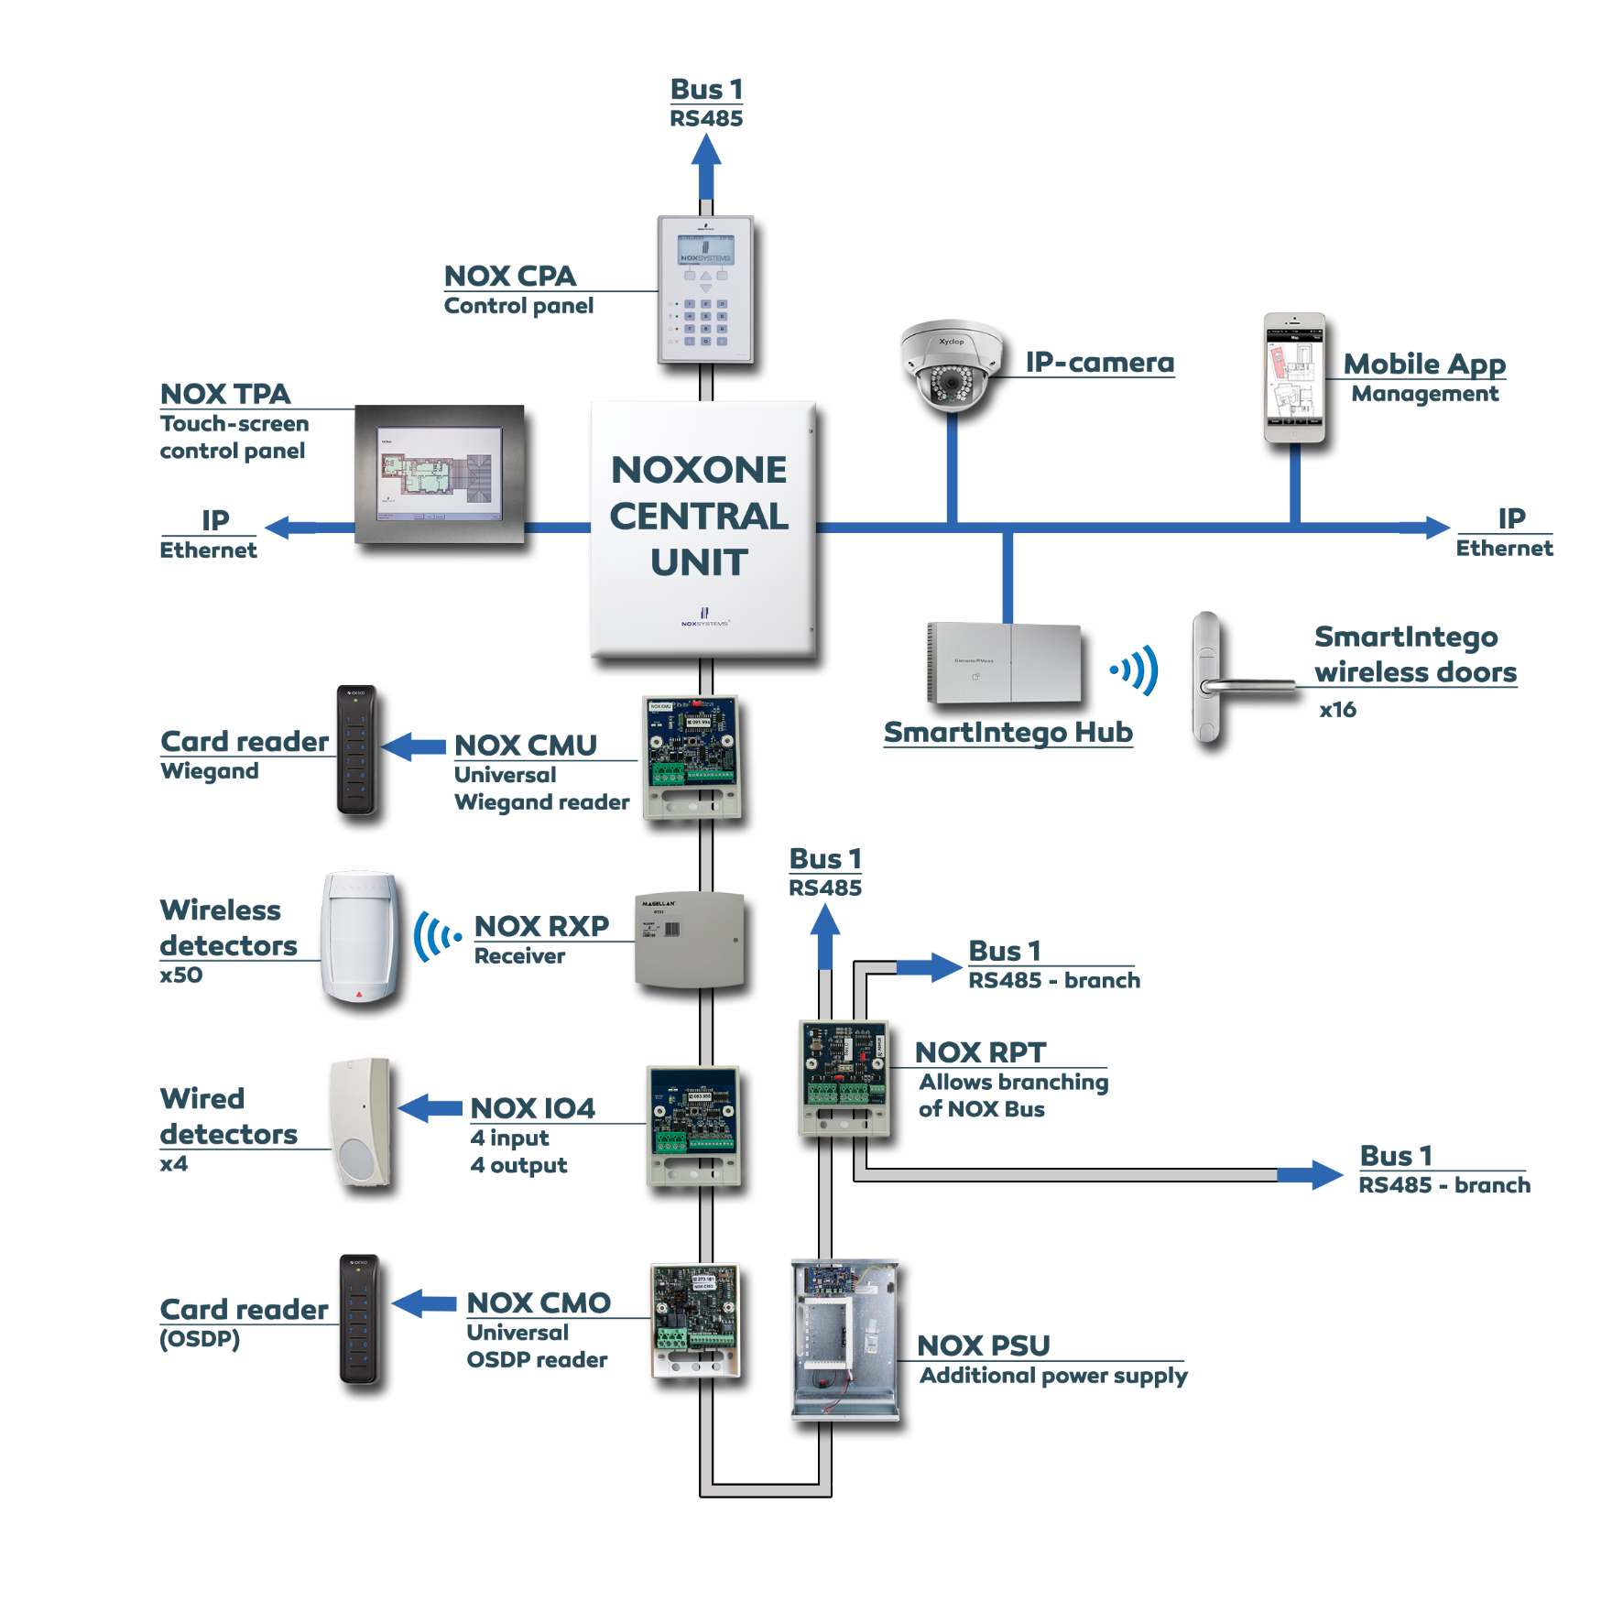
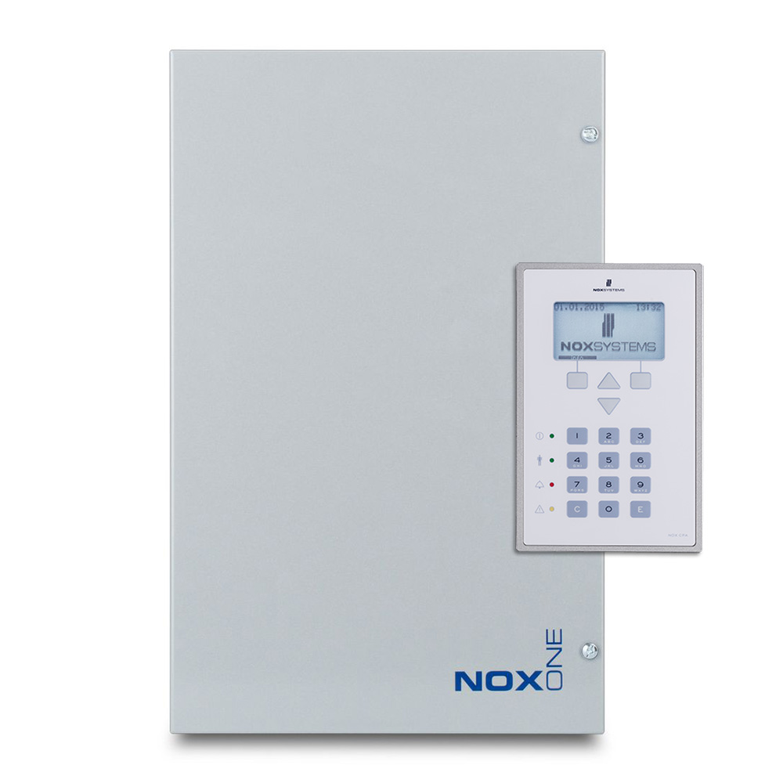
NOXONE
NOXONE central unit has 1 physical NOX bus (two-way)

Slide 7
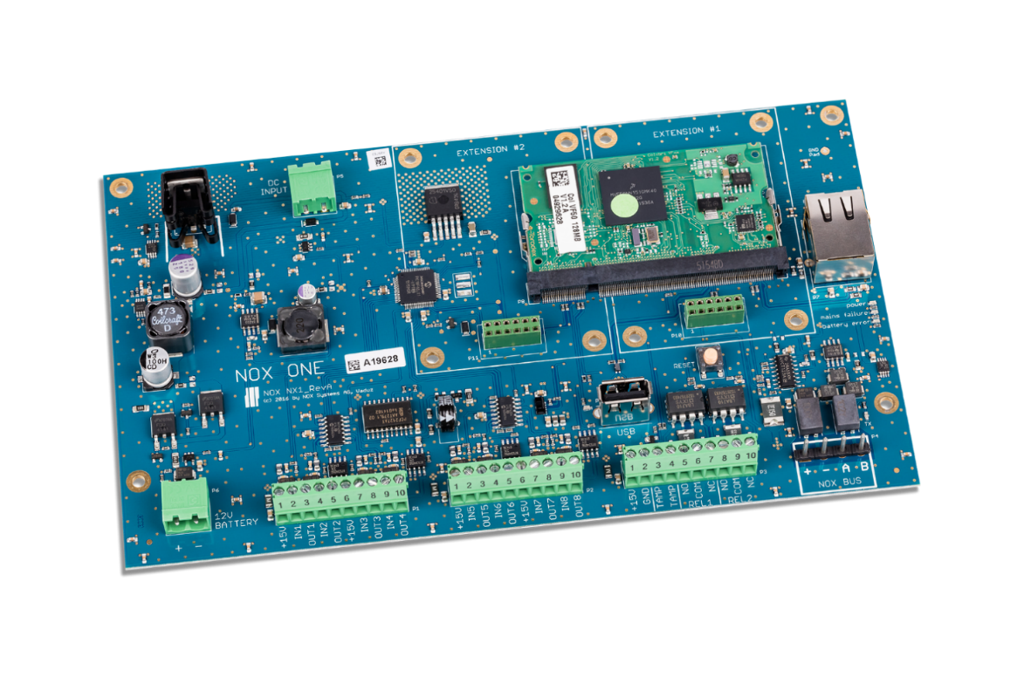
Modules on the bus
Easy service and replacement - Every module contains a unique factory defined address.
Flexibility is in focus with NOX
You adapt the system with modules, based on the functionality you need.
Secure - Data is transmitted to the central unit via the NOX bus (RS485)
All modules can be placed everywhere on the NOX bus
– both access and alarm modules
Flexibility –Find and choose third party technology on the global market.

Slide 8
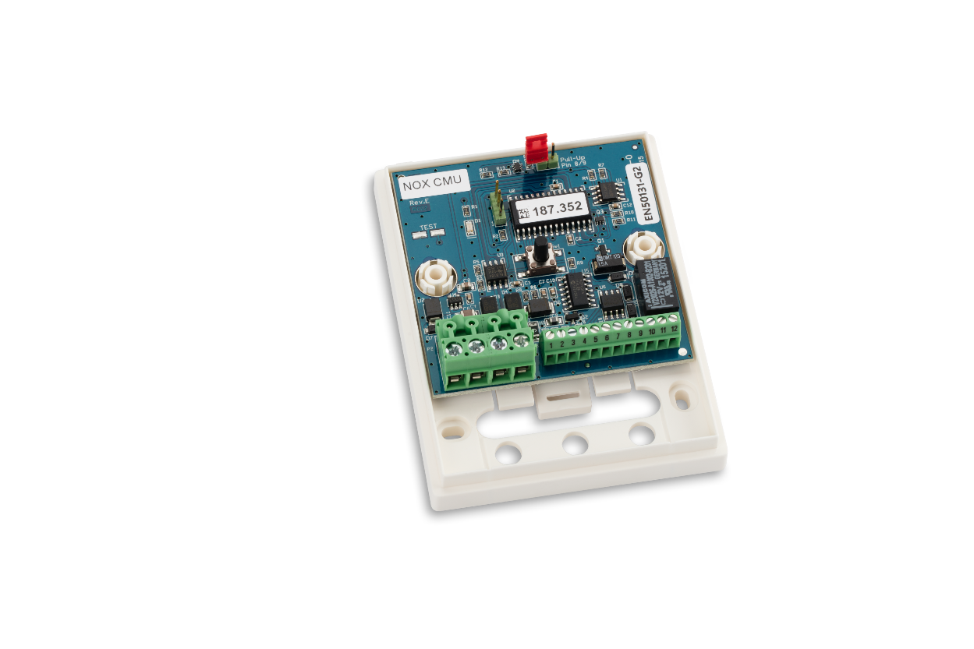
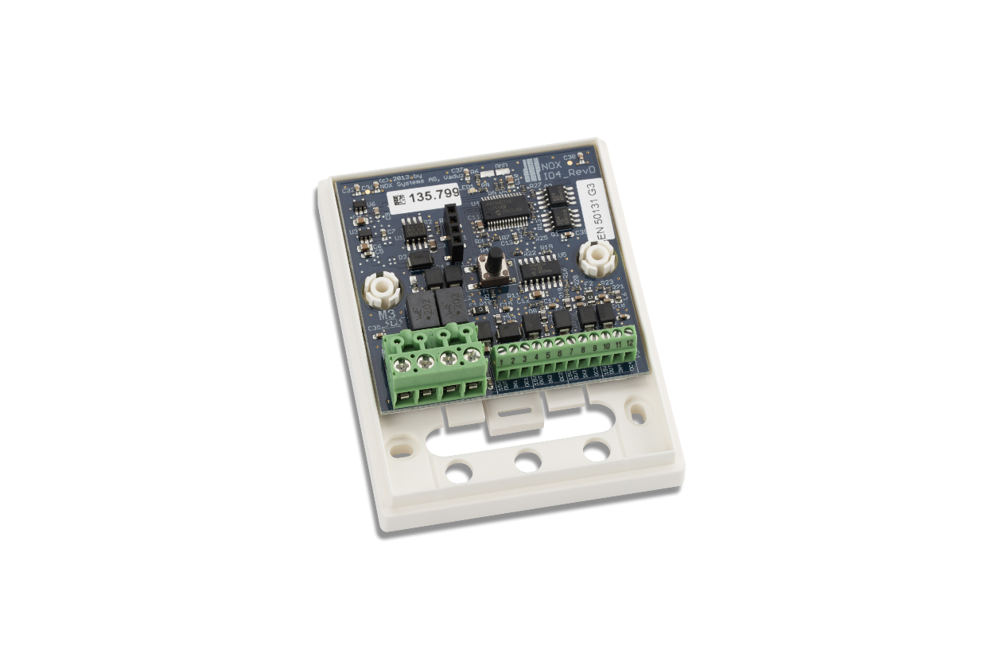
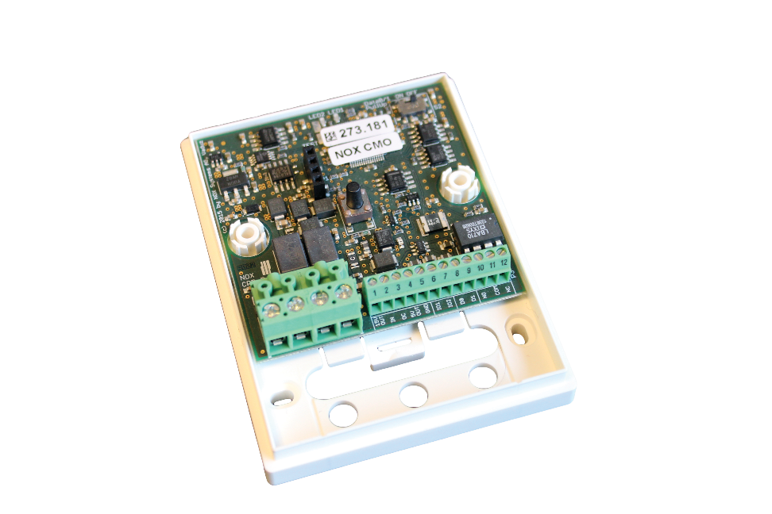
Modules
NOX CMU
NOX CMO
NOX IO4
• Door module
• Card Readers with Wiegand interface
• Programmable input/output/Relay
• Door module (In-and-out)
• Card Readers with OSDP interface
• Programmable input/output/Relay
• Connection of detectors
• Universal I/O4- module

Slide 9
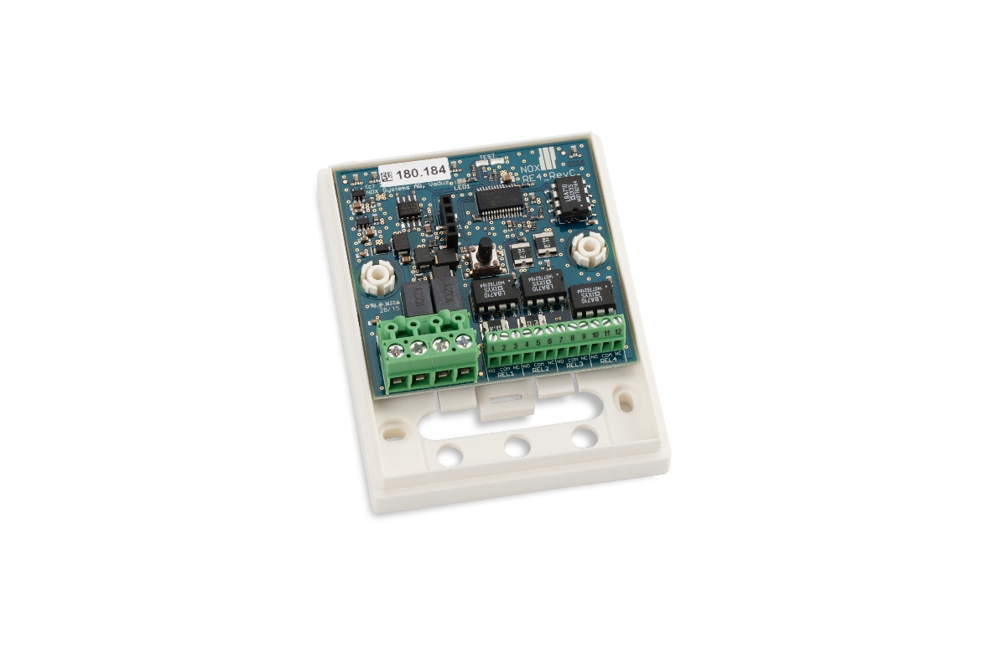
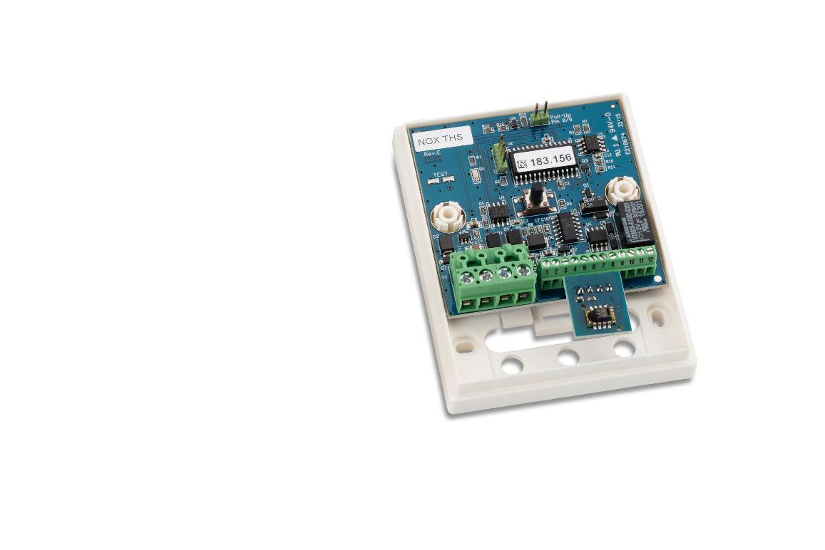
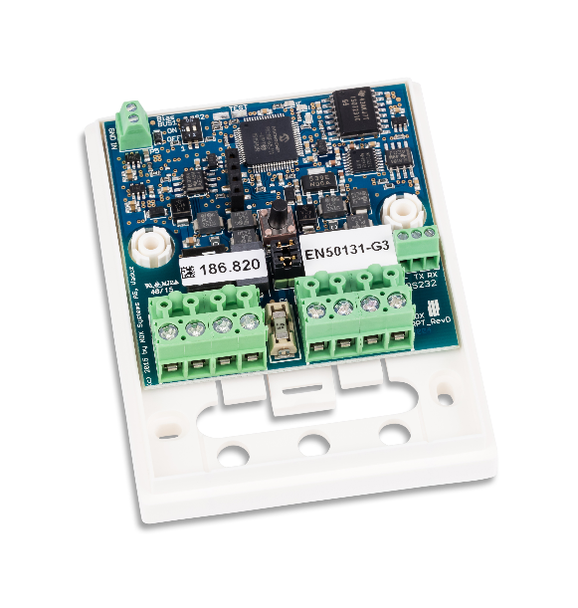
Modules
NOX RPT
NOX RE4
NOX THSi
• Allows extra 72 modules
• Branch off NOX bus
• Possible IP-bus
• Relay based signaling
• Elevator control
• Sirens/Horns
• Temperature and humidity measurement
• External sensor can be added
• Relay (e.g., Controlling ventilator)

Slide 10
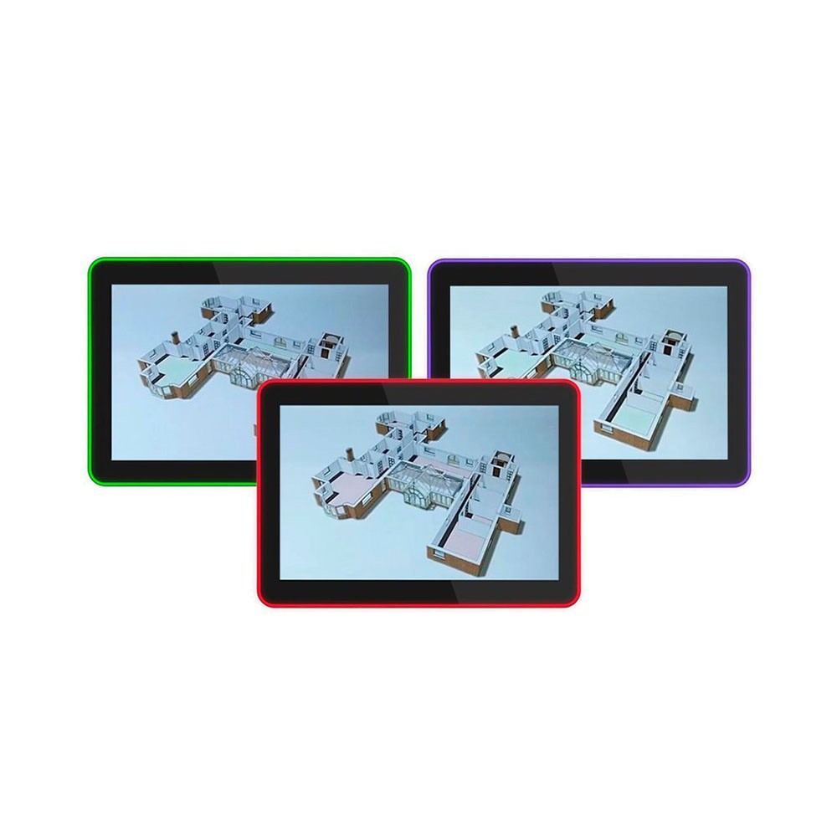
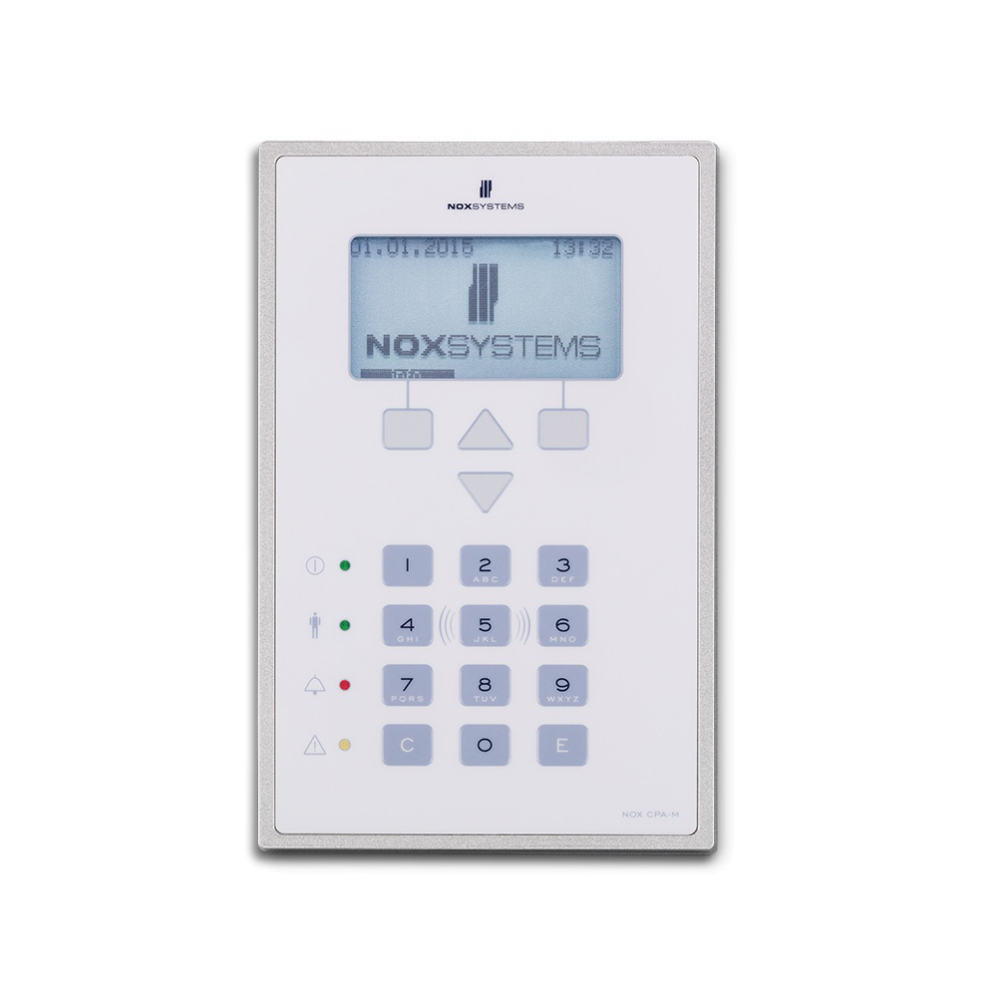
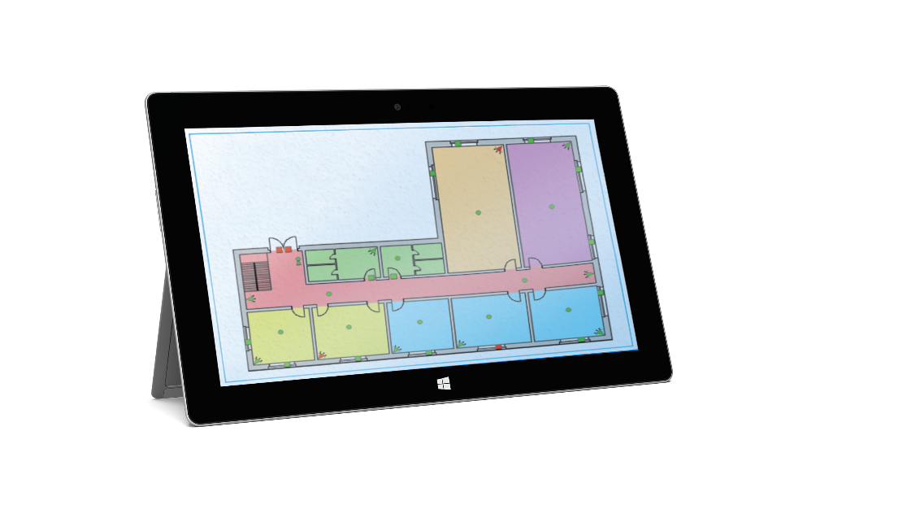
Flexible Control
Touch Screen
NOX CPA
Windows
• 10,1” Touch tablet
• Control areas, users, logs and alarms
• Map and floorplans
• LED bar with customizable functions
• Control panel with display
• Optional card reader
• Control areas, users, logs and alarms
• Computer / windows tablet
• Map and floorplans
• Control areas, users, logs and alarms

Slide 11
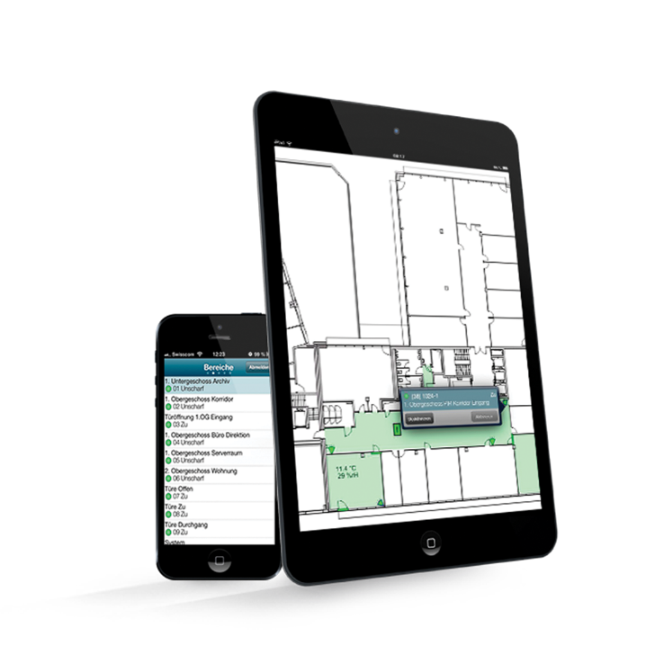
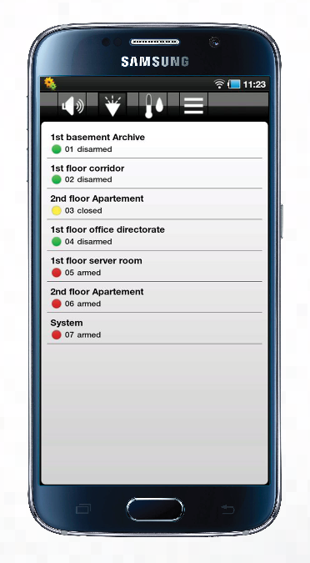
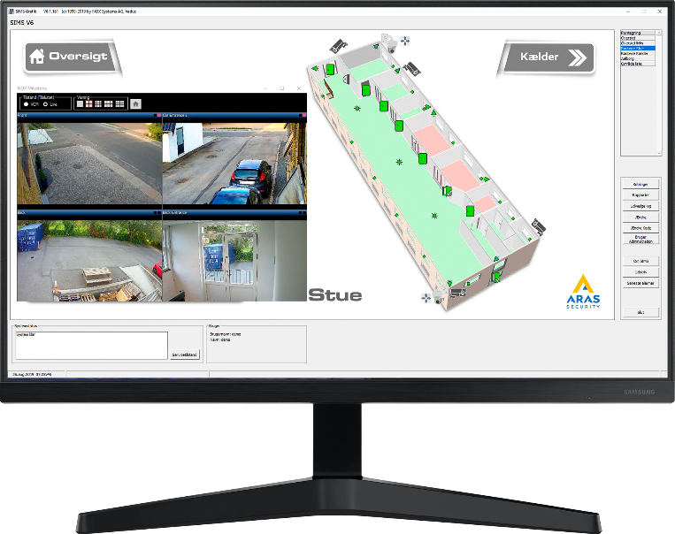
Flexible Control
NOX iOS App
NOX Android App
SIMS
• Smartphones and tablets
• Map and floorplans
• Live-stream from IP-camera
• Push messages when alarm
• Control areas, users, logs and alarms
• Multi-site management system
• Handles +1000 NOX networks
• Map and floorplans
• Live-stream from IP-camera
• Manage integrations
• Control areas, users, logs and alarms

Slide 12
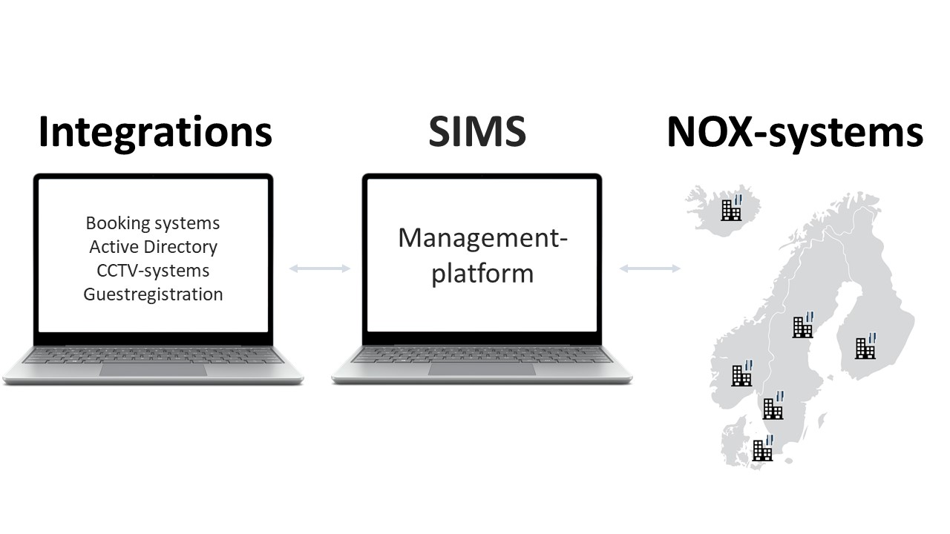
SIMS
Security Information Management System
Graphical interface with dynamic floor plans
Control of multiple NOX systems (+1000)
25 clients can operate the system simultaneously
The Complete Overview
Manages, monitors, connects
and expands your NOX systems
Data stored in SQL database
Area management and access control in all NOX systems
Automatic disarming and arming
Alarm processing, user management and reporting
Log entries limited by SQL Server capacity (SQL Express 1,000,000,000)

Slide 13
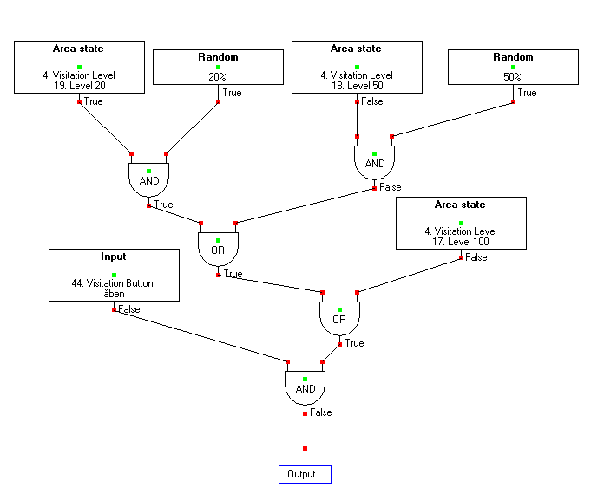
Logical Programming
NOX lets you tailor how all modules
behave based on needed functions.
(…but you don’t have to).
Logical programming gives you the flexibility
to meet all demands from the user.

Slide 14
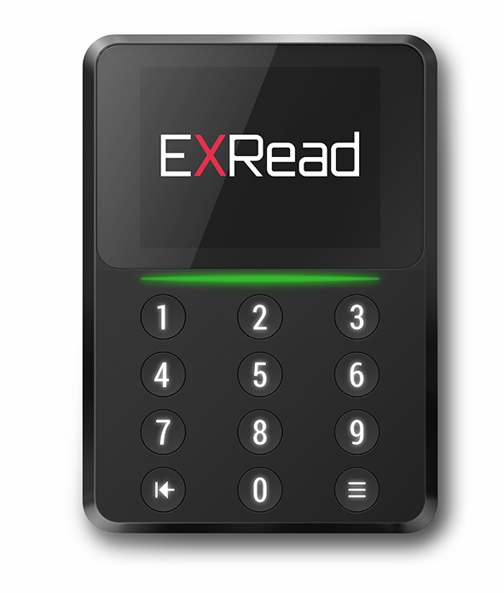
Card Readers
Choose your readers on the global market
OSDP interface
Connects to a NOX CMO module.
Encrypted communication between reader and card reader module.
Wiegand interface
All readers with Wiegand interface can be connected to a NOX CMU module.

Slide 15
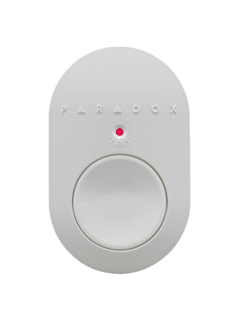
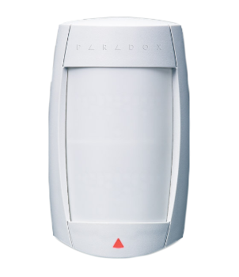
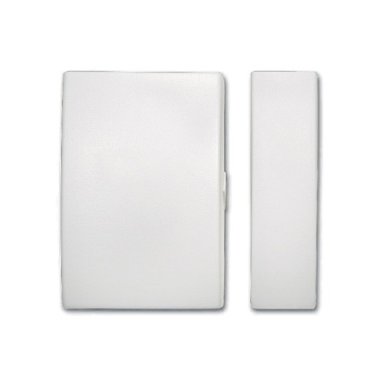
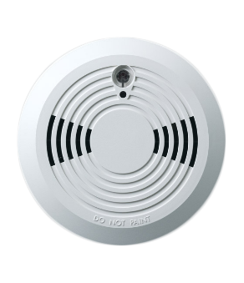
Wireless Detectors
Wireless detectors
Receiver module connects to the NOX Bus
PIR motion detectors
Smoke sensors
Magnetic contacts
Acoustic glass break detectors
…and many more.

Slide 16

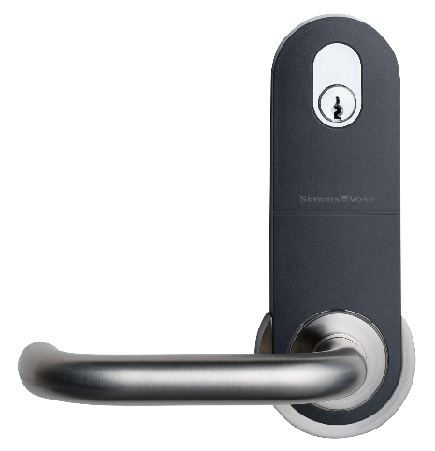
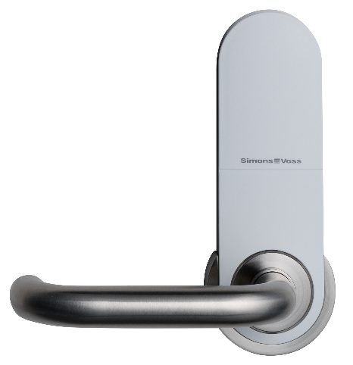
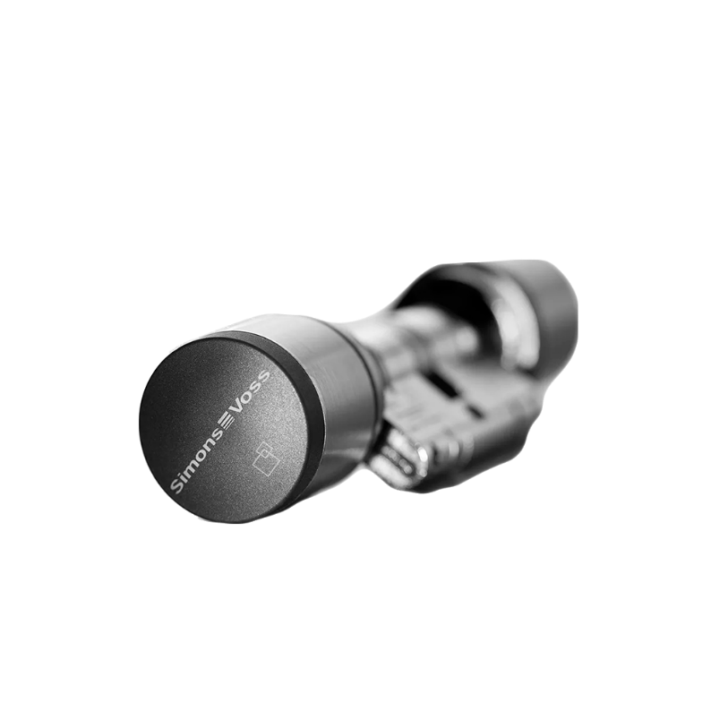
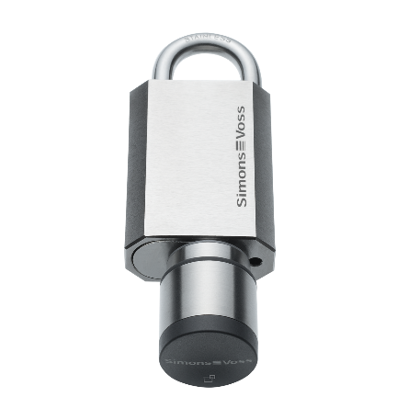
Wireless Card Readers
Wireless doors with card readers
Online/Offline
Door handles
Cylinders
Padlocks
Cabinet locks

Slide 17

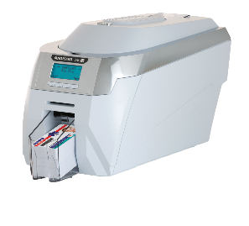
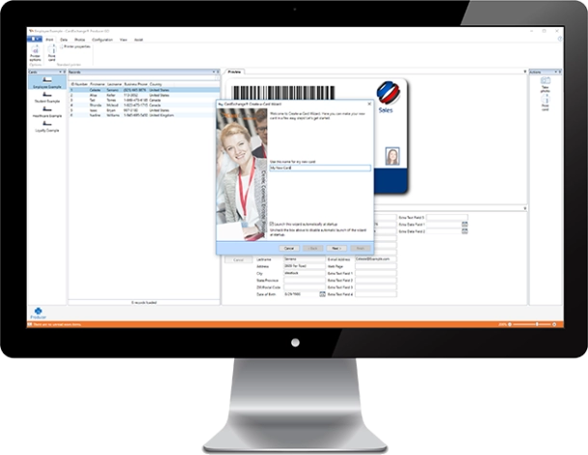
ID-card Print
NOX-integration with CardExchange
Easy ID-card production with CardExchange integration.

Slide 18
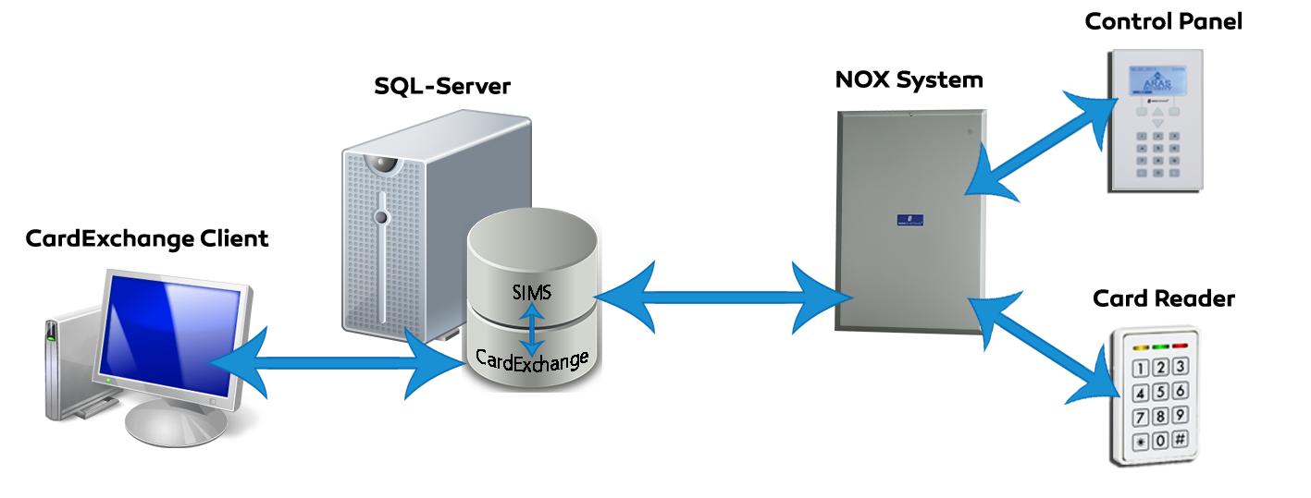
ID-card Print with AD
NOX-integration with CardExchange
Possible setups:
A user in Active Directory gets a card printed,
and is added automatically in SIMS.
Add a user's card number in Active Directory.
Access permissions are automatically transferred to SIMS.

Slide 19
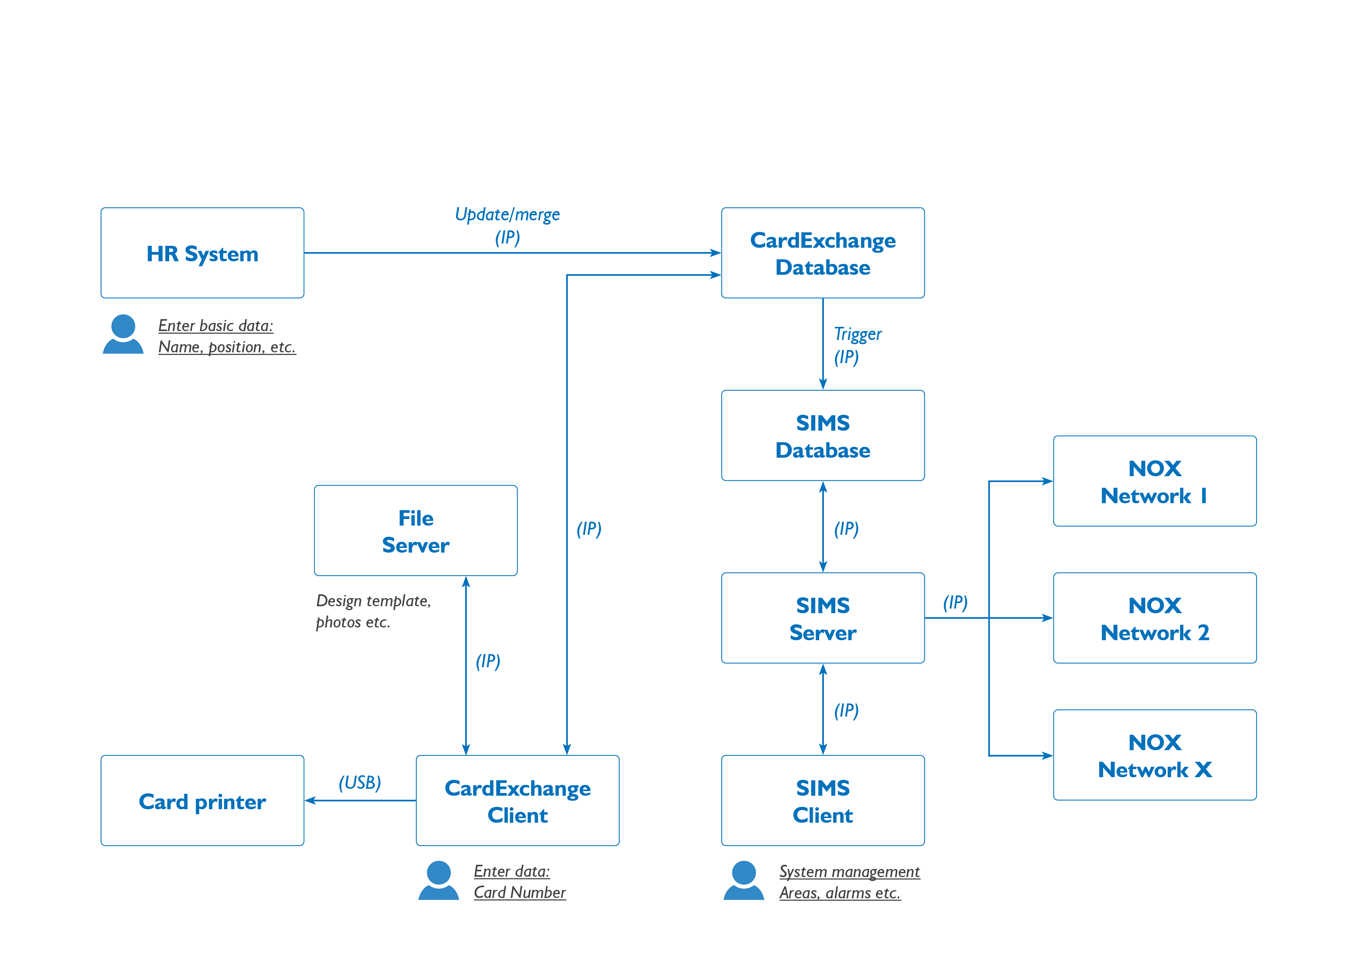
ID-card Print with AD

Slide 20
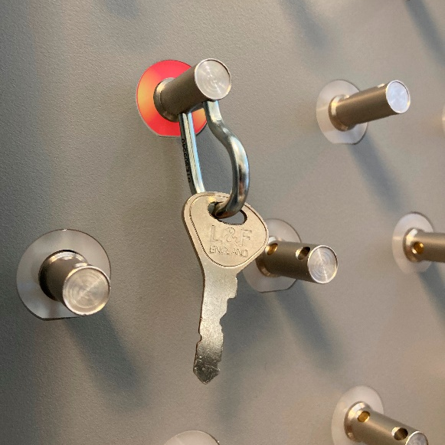
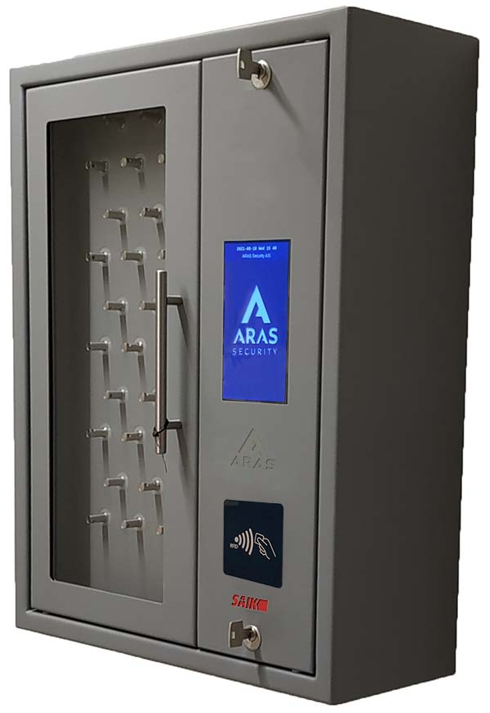
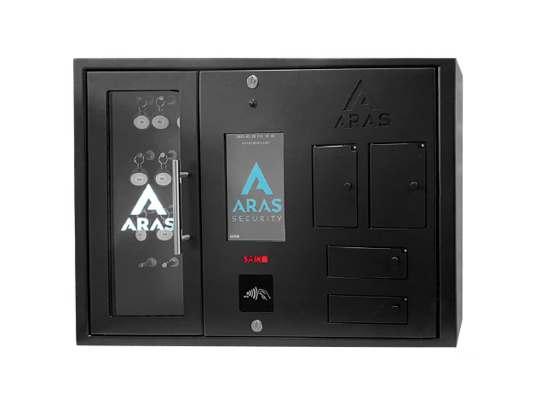
KeyBox
Intelligent Key storage and management
Integrated with NOX.
Available in every size and color.

Slide 21






Integrations
Some of the completed NOX integrations

Slide 22







CCTV
NOX is integrated with several CCTV-protocols
CCTV integrations are made through IP-connection.

Slide 23






In-House Development
ARAS develops applications for NOX
Based on the needs of the end-users.

Slide 24

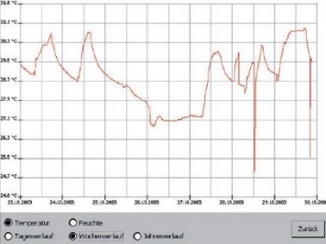
Optimize Energy Use
Intelligent building management
Automatic measurement and registering.
Lighting
Temperature
Humidity
Adapt usage of lighting, ventilation and heating
to time and presence.

Slide 25




NOX is for…
NOX is approved and registered as a
EN-50131 Class 3 combined security
system in Scandinavia and Europe:
Germany VdS: EN-ST-000185
Denmark F&P: 10.212-11305
Norway FG: SA-1172/22
Sweden SBSC: 14-376
(Larmklass 3 – Miljöklass II)
Housing
…every sector
Retail
Finance
Defense
Government
Logistics
Service
Culture
Construction
Education
Healthcare
Security

